Slide 1
实现梦想
Touching the Dream
Coming together is a beginning. Keeping together is progress. Working together is success.

Slide 2
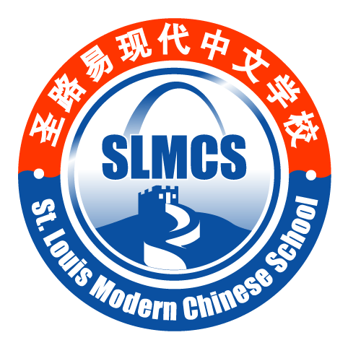
St. Louis Modern Chinese School
The St. Louis Modern Chinese School was founded in 1997 as a family-oriented non-profit Chinese language school
Started with 40 students in 1997, the St. Louis Modern Chinese School currently has over 700 students enrolled
SLMCS is operated by volunteers and its financial support is mainly from tuitions and donations from individuals and private business and institutions.

Slide 3
Accomplishments of SLMCS
Top five in Google search for Chinese school
SLMCS is an active member of Chinese School Association in the United States (CSAUS)
Largest in St. Louis and 501(c) not-for-profit
Reach every corner and every company in great St. Louis area
Offer various Chinese and Chinese culture programs

Slide 4
Challenges Facing SLMCS
We (over 700 registered students) may not be able to renew our yearly lease and become homeless,
The costs of leasing the current school have increased by 20% per year in the last two years.
Restrictions on the school’s curriculum and expansion

Slide 5
Our New Building
Building sold $7.5 mill. in 2007
St. Louis County assessed $3.6 mill. in 2010-2012
Initial bidding price $1.5 million
Re-negotiated final purchase price $1.2 mill. (risking a personal loss of $10,000) – saved SLMCS $300,000

Slide 6
How to Pay for the Purchase
SLMCS Saving | $xxx,xxx
Donation | $xxx,xxx
Bank Loan(4.5% - due in 4 yrs) | $xxx,000
Building Cost | $1,200,000

Slide 7
Remodeling and Furnishing
Building remodeling
Donation from families and St. Louis community
Volunteer work! (too many to count)
Furniture donated from several institutions

Slide 8
People are Our Treasure!

Slide 9
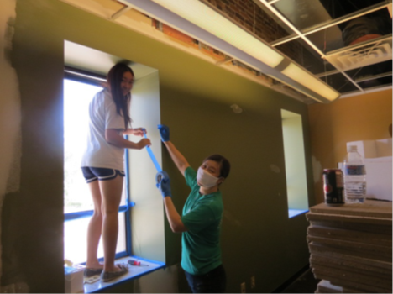
We have Hard-Working People Including Our Younger Generation!

Slide 10
Together, Our Dream Came True!
SLMCS successfully opened for Classes on Sept. 8, 2012!

Slide 11
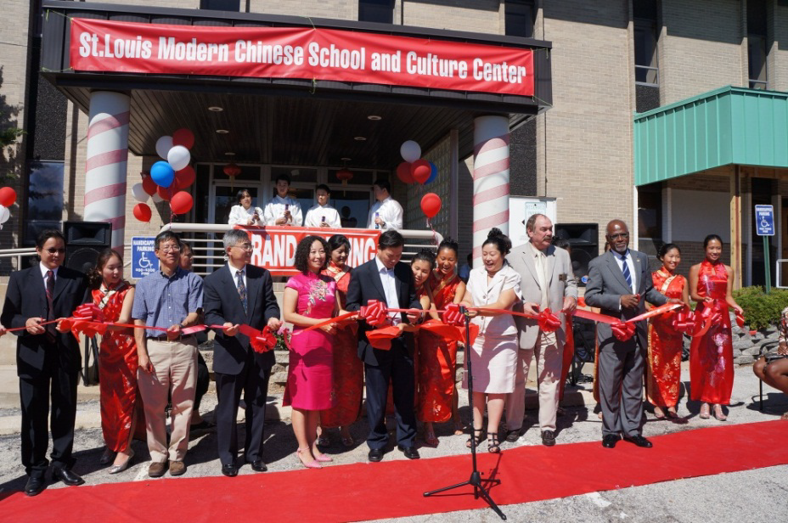
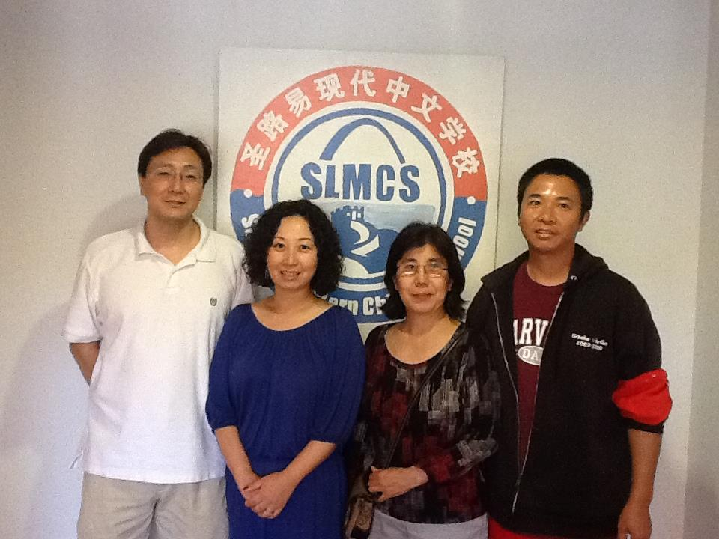
We Celebrated Our New Home

Slide 12
